Slide 1
GROUP 12 MEMBERS:
Vivian maiyo
George tido
CAROLINE KISAULU
LEWIS GITARI
CAROLINE NGABU
FAITH gITAU

Slide 2
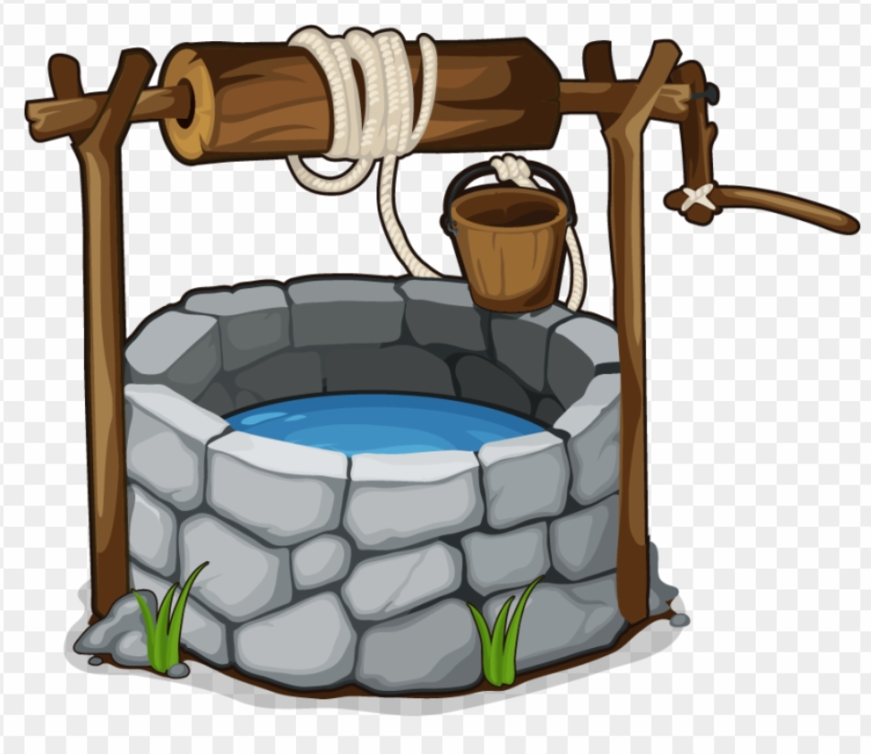
the TANZANIAN WATER WELLS
IS
THIS WELL FUNCTIONAL
?

Slide 3
Overview
The objective of this project is to develop a machine learning classification model that accurately predicts the functionality of water wells in Tanzania.
By doing so, we aim to improve access to clean ad reliable water sources by identifying wells that are functional, non functional and those that need repair.
In our modeling, we shall use Tanzanian wells data from DrivenData labs that we shall use to train and validate our model to predict functionality status of water wells.
We shall make data driven recommendations to stakeholders and policy makers on where attention is needed to ensure water crisis in Tanzania is resolved.

Slide 4
Outline
Business Problem
Data and Methods
Findings
Conclusion
Recommendations

Slide 5
Business Problem
39% of Tanzanians do not have access to basic water supply.
Lack of reliable infrastructure to monitoring wells leading to inefficiencies in resource allocation and delays in addressing non functional wells.
Traditional approaches in management have been ineffective as installed water wells cease to function over time while others remain in dilapidated conditions needing repair for a long time.
Pressing need to be able to predict the functionality status of wells in Tanzania to redirect stakeholders and policy makers attention and resources where needed in a proactive approach.

Slide 6
DATA AND METHODS
Tanzanian water wells data set.
Contains 39 features describing wells such as location, quality, quantity, funder, installer, management e.t.c
Data cleaning to address data issues such as missing values, data types e.t.c
Exploratory data analysis
Feature engineering
Classification modeling

Slide 7
Findings

Slide 8
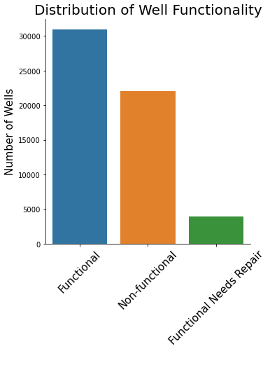
OVERALL WELL FUNCTIONALITY
More than half of the wells are functional.
Minority of the wells are functional but need repair.
A significant proportion of wells are non-functional.

Slide 9
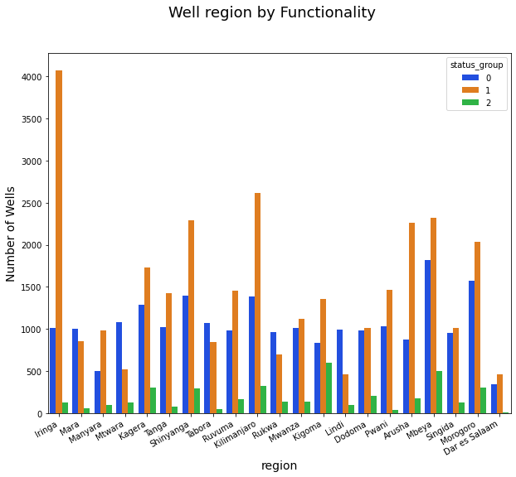
WELL FUNCTIONALITY PER REGION
Mtwara region and lindi region stand out for having a higher proportion of non functional wells.

Slide 10
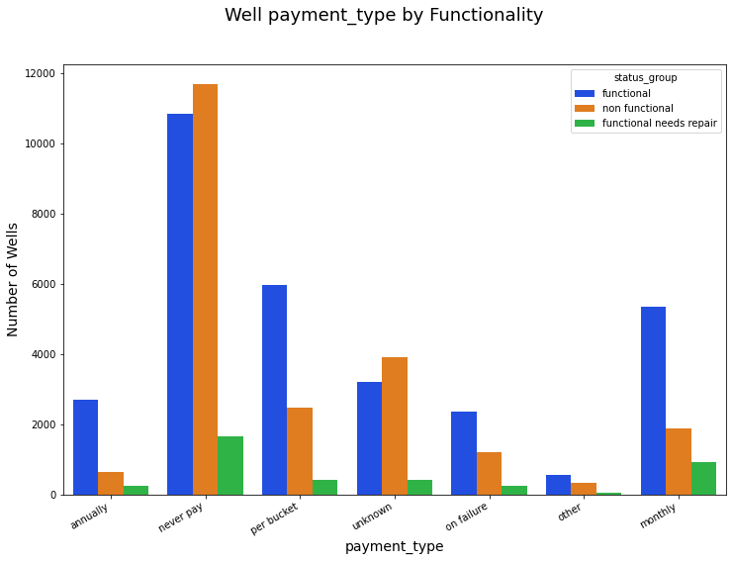
Well functionality vs payment
There is high proportion of non-functioning wells where there is no payment compared to wells where there is payment

Slide 11
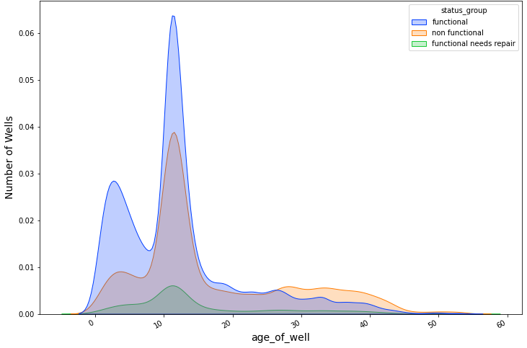
FUNCTIONALITY BY AGE
There is a higher proportion of functional wells between 0 and 15 years.
The proportion of non functional wells significantly increase from 30 years of age onwards.

Slide 12
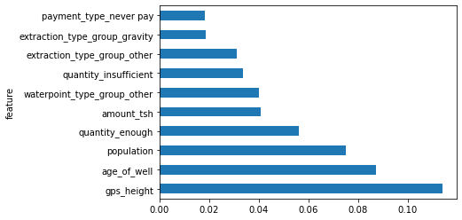
FEATURE IMPORTANCE
These are the top ten important features in predicting well functionality.
Altitude of the well has the highest influence on the functionality of the well.

Slide 13
Results
There is a high proportion of non functional wells accounting for 38% % of the total wells.
Well projects funded by the Government of Tanzania and the Ministry of Water are more likely to be non functional.
Mtwara, Lindi, Ruvuma/Southern Coast and L. Rukwa basin regions have a high proportion of non functional water wells

Slide 14
Results
Free well projects and where public meetings are not held, have a higher proportion of non functional wells compared to the functional wells.
Well projects that are older have a higher proportion of non functional wells than new ones(0 - 15 years).
Dry wells, wells with salty water and wells with dam and lake as a source are more likely to be non-functional.

Slide 15
CONCLUSION
One of the main causes of water crisis faced by Tanzanian population has majorly been occasioned by the high number of non functional/dilapidated wells across the regions.
Being able to predict which wells are non functional or need repair can ensure the wells being installed remain functional and prompt quick action incase of a failure.

Slide 16
Recommendations
Well projects being funded by the government and its ministry should be thus be closely monitored during the installation and followed closely to ensure continued function
Mtwara and Lindi Regions and wells in Ruvuma/Southern Coast and L. Rukwa basin should be prioritized in repair of non functional and functional wells that need repair.
Introduce and promote well fees and public meetings to enhance community ownership thus better maintenance of wells.
Older wells, dry wells and wells with salty water should be monitored more closely as they are more likely to fail

Slide 17
Further Analysis
Further hyperparameter tuning: Hyperparameter tuning can be explored further using Gridsearch to further improve on the models used in prediction.
Exploring more model types such as XGboost, Adaboosting, naive bayes, svm and model stacking that were not used here can be explored to find a better performing model.
More information on data features some symbols and abbreviations used in the data are not universal. More information on the data can enhance the data cleaning process especially in the funders and installers features to enhance the cleaning process and consequently the model outputs.

Slide 18
Thank You.
Q&A

